Slide 1
Functional analysis of BBS3 A89V that results in non-syndromic retinal degeneration
Pamela R. Pretorius, Mohammed A. Aldahmesh, Fowzan S. Alkuraya, Val C. Sheffield, and Diane C. Slusarski
Presented by Philip Huynh

Slide 2
Outline
Introduction/Background
Bardet-Biedl syndrome
Objectives
Results
Conclusion/Discussion
Future Research

Slide 3
Background
Bardet-Biedl Syndrome (BBS)
Heterogeneous autosomal recessive disorder
Syndromic form of retinal degeneration
Characteristics
Obesity, polydactyly, renal abnormalities, hypogenitalism, cognitive impairment
Retintis pigmentosa

Slide 4
Background
14 BBS genes (BBS1-14)
BBS3 and BBS3L
BBS3
Member of Ras family of small GTP-binding proteins
BBS3L
Longer eye-specific transcript of BBS3
Required for retinal organization

Slide 5
BBS3 and BBS3L
Knockdown of bbs3 using an antisense oligonucleotide [Morpholino (MO)]
Results in delays in intracellular melanosome transport and vision impairment in zebrafish
Test functional requirements of BBS3 and BBS3L
RNA encoding human BBS3 or BBS3L co-injected with bbs3 aug MO
BBS3 sufficient to suppress melansome transport delay but not vision defect
BBS3L was able to rescue vision defect but not the melanosome transport delay

Slide 6
A89V Mutation
Missense mutation at position 89
Alanine to valine
Discovered in a consanguineous Saudi Arabian family
BBS3 A89V
Non-syndromic retinitis pigmentosa

Slide 7
Objectives
To study the A89V mutation and why the Saudi Arabian family could show non-syndromic retinitis pigmentosa
If BBS3L A89V could be stability expressed
Study the effects of A89V mutation in intracellular melanosome transport and visual function

Slide 8
BBS3 Conservation and BBS3L A89V expression
BBS3 sequences evolutionary conserved among vertebrate species
Difference between BBS3 and BBS3L not within mutation site
Mutation region identical
BBS3L A89V could be stably expressed

Slide 9
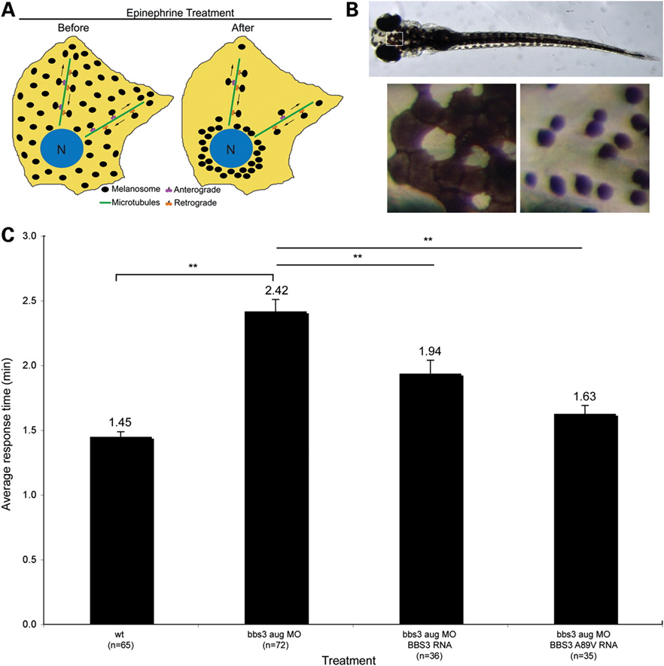
BBS3 A89V Functions in Melanosome Transport
Test the rate of cellular trafficking
Rescue tests of melanosomes from perinucleus
Co-injection with BBS3 or BBS3 A89V with bbs3 aug MO
BBS3 A89V was able to restore transport times back to wild type levels

Slide 10
BBS3L A89V Does not Function in Vision
BBS3L necessary for proper vision
Vision startle assay
Co-injection of BBS3L or BBS3L A89V with bbs3 aug MO
Crx knockdown used as control for vision impaired zebrafish
BBS3L A89V unable to restore vision
Notes:
Crx- cone rod homeobox

Slide 11
Conclusion
A89V mutation plays a large role in proper visual function
Reason for A89V mutation only displaying retinitis pigmentosa
Combination of melanosome transport tests and vision startle assay
Melanosome transport tests showed that BBS3 A89V was able to suppress the defect
Intracellular melanosome movement is important in the other phenotypes that are associated with BBS
Vision startle assay showed how the mutation in BBS3L A89V was unable to correct the vision defect
BBS3 and BBS3L are isoforms that can have different splice variants and mutations that generate from a single gene could contribute to a phenotypic complexity in disease

Slide 12
Future Research
Difference in region between BBS3 and BBS3L
BBS3 known Ras family of small GTP binding proteins
Mutation plays role in altering function
Critique
Comparing two different transcripts when mutation only discovered in BBS3

Slide 13
Questions??

